Slide 1

Building Mobile Apps with Ionic 2, Angular 2, and TypeScript
introduction
Steve Michelotti
@smichelotti http://stevemichelotti.com

Slide 2
What is Ionic 2?
Mobile-optimized open source framework for building cross-platform apps (HTML/JS/CSS)

Slide 3
Web Development Tools

Slide 4
Built on Top of Angular 2

Slide 5
Built for Native Cordova Apps

Slide 6
What is Cordova?
JavaScript API “wraps” native API
Native Mobile Apps (HTML/JS/CSS)
Plugin Ecosystem
Millions of Downloads

Slide 7
Why Ionic 2?
Angular 2 / TypeScript
Navigation
Platform Theming
Build Tools
Performance

Slide 8
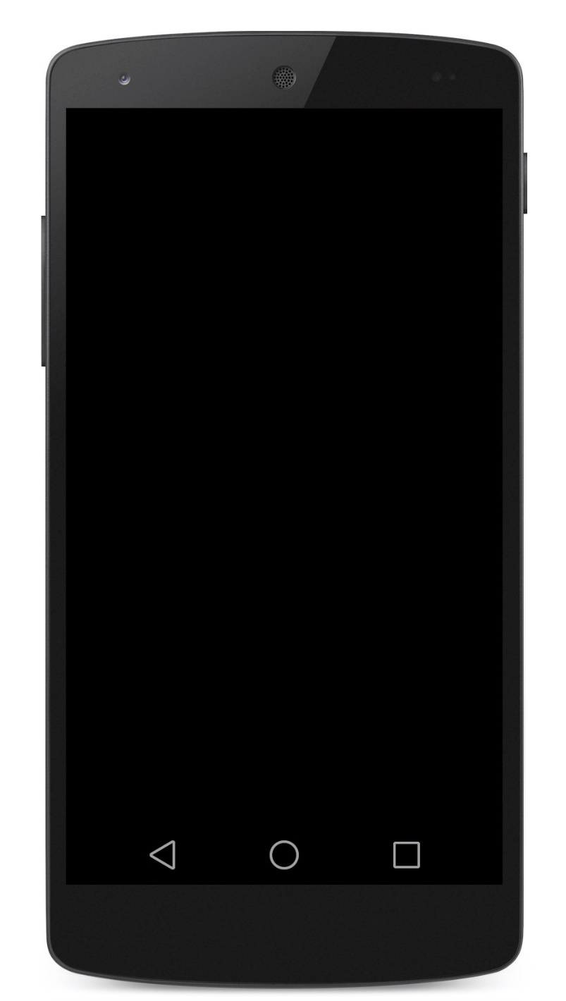

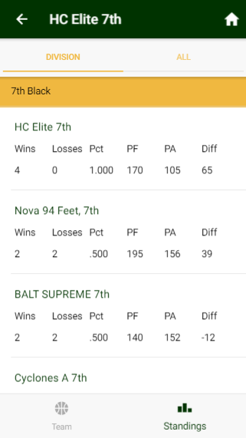
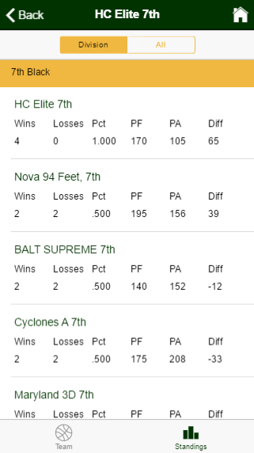
Multi-Platform Theming

Slide 9
Helpful Prerequisites
TypeScript/JavaScript
https://www.pluralsight.com/courses/typescript
Angular 2
https://www.pluralsight.com/courses/angular-2-first-look
https://www.pluralsight.com/courses/angular-2-getting-started

Slide 10
Let’s Get Started!

Slide 11
Buttons
Navigation

Slide 12
Cards
Badges
Input
Toolbars
Grid System

Slide 13
Services
Third-Party Libraries

Slide 14
Toasts
Alerts
Modals
Lists

Slide 15
Virtual Scroll
Searchbar

Slide 16
Ionic Native

Slide 17
Ionic Native

Slide 18
Go Build Great Apps!!

